Slide 1

Agency Pulse
June 2015-May 2016
This document contains confidential information that is proprietary to EZLynx. Neither the document nor the information contained therein should be disclosed or reproduced in whole or in part, without the express written consent of EZLynx.

Slide 2
Agency Pulse Introduction
EZLynx Agency Pulse is a monthly analytics report of aggregated data generated from an agency’s EZLynx Rating Engine and Management System account.
The Agency’s data during the period June 2015-May 2016 was analyzed and it’s health was observed.

Slide 3

Agency Pulse
Summary
This document contains confidential information that is proprietary to EZLynx. Neither the document nor the information contained therein should be disclosed or reproduced in whole or in part, without the express written consent of EZLynx.

Slide 4
Agency Pulse Current Scenario
 | January 2016 | May 2016 | % Change
Total Annual Premium | $1,805,366 | $1,670,663 | -7.5%
Total Active Policies | 1,242 | 1,142 | -8.1%
Total Active Customers | 852 | 791 | -7.2%
Average policies/customer | 1.46 | 1.44 | -1.37%
Notes:
Average policies/customer has reduced only by 1%,so it does not mean customers had less no. of policies, but because agency did not retain customers.

Slide 5
Agency Pulse
Analysis of Total Annual Premium
This document contains confidential information that is proprietary to EZLynx. Neither the document nor the information contained therein should be disclosed or reproduced in whole or in part, without the express written consent of EZLynx.

Slide 6
Agency Pulse Total Annual Premium
The Total Annual Premium increased significantly by 21.1% and was $1.9M in December 2015.
Notes:
Nov | Dec
1108 policies | 1278 policies (170 policies more)
Approx $100,000 | Approx $400,000

Slide 7
Agency Pulse Total Annual Premium
The Total Annual Premium increased significantly by 21.1% and was $1.9M in December 2015.
The increase was primarily caused due to policies increase in FL
Notes:
** Increase in policies because a new agency was purchased in FL.
Nov | Dec
1108 policies | 1278 policies (170 policies more)
Approx $100,000 | Approx $400,000

Slide 8
Agency Pulse Total Annual Premium
But, the total annual premium has declined by 10.5% since December 2015.
Notes:
10.5% is the decrease from Dec’15 to May’16
Consistently lost customers and policies each month.
Retention also decreased during this period.

Slide 9
Agency Pulse Total Annual Premium
With continual decrease of the total annual premium and no corrective action, premium is projected to reduce to $1.5M in December 2016.
Notes:
Premium decreased by 3% and 1% alternatively. Using this, the premium was estimated to decrease to $1.5M

Slide 10
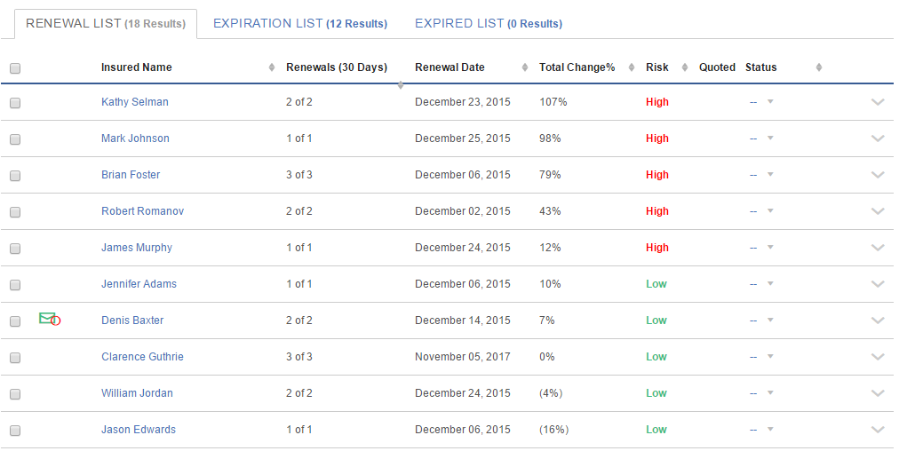
Agency Pulse Total Annual Premium
To prevent further decline of the total annual premium and gain competitive edge over others, it is recommended to use Retention Center.
Agencies using Retention Center have outperformed other independent agencies by 8 percentage points.

Slide 11
Agency Pulse Total Annual Premium
With Retention Center, high risk policies can be identified and customers can be retained by proactive communication.
The study done on agencies using Retention Center over a one year period had 8% increase in retention. We used the same in this projection.
Notes:
Estimating total premium
Total premium=old premium+(old premium*change in retention)

Slide 12
Agency Pulse Total Annual Premium
A $0.3M increase in annual premium can be observed using Retention Center.
The total annual premium is estimated to increase to $1.8M by the end of the year.

Slide 13
Agency Pulse Conclusion
Increase in Total Annual Premium if Retention Center is used
Customer Acquisition cost can be reduced by retention. According to IIA Dallas , improving customer retention by 5% can increase profit by more than 25%
Notes:
Profit includes premium and revenue.

Slide 14
Agency Pulse
Appendix
This document contains confidential information that is proprietary to EZLynx. Neither the document nor the information contained therein should be disclosed or reproduced in whole or in part, without the express written consent of EZLynx.

Slide 15
Agency Pulse Appendix

Slide 16
Agency Pulse Appendix

Slide 17
Agency Pulse Appendix
Notes:
Top 4 carriers are: 1)SafeCo Insurance
2)ASI(American Strategic Insurance)
3)Progressive
4)Homeowners

Slide 18
Agency Pulse Appendix

Slide 19
Agency Pulse Total Active Customers
December 2015 had the highest number of Active customers.
Since then, the number of customers has been higher than the number around the same time last year

Slide 20
Agency Pulse Customers by Premium Range
On average 52% of customers are in the premium range $1,001-$2,500.
The number of customers in the premium ranges $0-5,000 significantly increased in December 2015.
December had the highest number of customers in all premium ranges.

Slide 21
Agency Pulse Customers by Number of Policies
On average 59% of customers had one policy and 34% had 2 policies.
7% of customers had 3 or more policies.

